Slide 1


INSTITUTE FOR ADVANCED COMPUTING AND SOFTWARE DEVELOPMENT AKURDI, PUNE
WEB TESTING USING VAPT
GROUP NO: 20
Janhavi Prabhakar More (230319)
Sanchi Dhabarde(230342)
CENTRE COORDINATOR PROJECT GUIDE
Mr.Rohit Puranik Mr. Kartik Awari

Slide 2

WEB TESTING USING VAPT

Slide 3
WHAT IS VULNERABILITY ASSESSMENT?
A vulnerability assessment is a systematic review of security weaknesses in an information system. It evaluates if the system is susceptible to any known vulnerabilities, assigns severity levels to those vulnerabilities, and recommends remediation or mitigation, if and whenever needed.

Slide 4
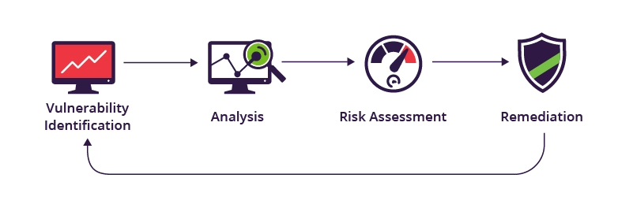

Slide 5
WHAT IS PENETRATION TESTING?
A penetration test (pen test) is an authorized simulated attack performed on a computer system to evaluate its security. Penetration testers use the same tools, techniques, and processes as attackers to find and demonstrate the business impacts of weaknesses in a system.

Slide 6
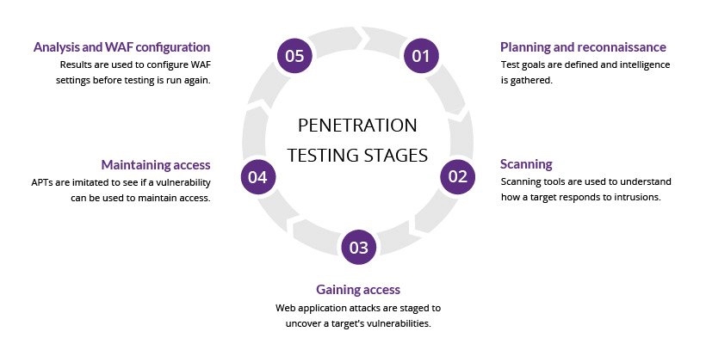

Slide 7
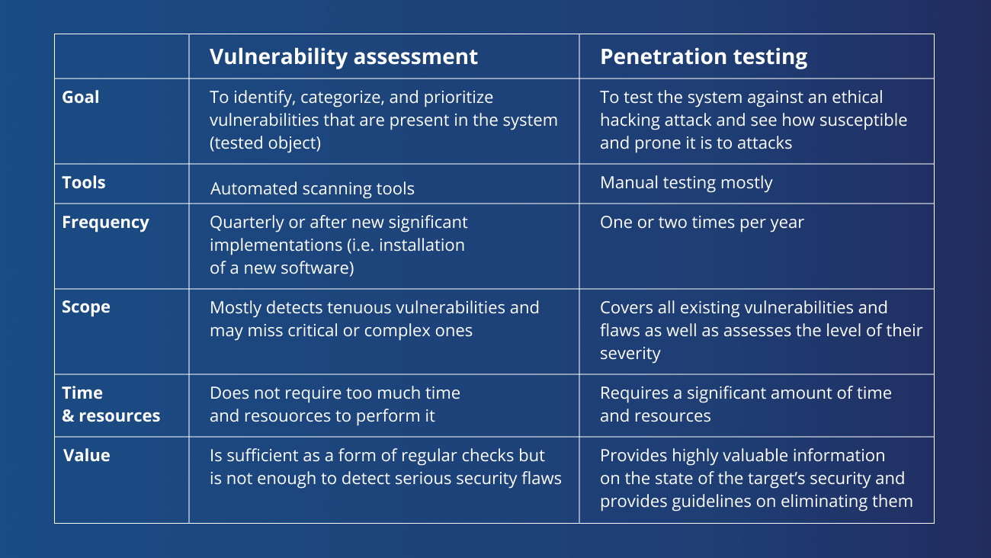

Slide 8
SQL INJECTION:
SQL Injection is a type of cyber attack where an attacker injects malicious SQL code into an application's input fields. This code is then executed by the application's database, allowing the attacker to perform unauthorized actions on the database. These actions can include extracting, modifying, or deleting data, or even taking control of the entire database.

Slide 9
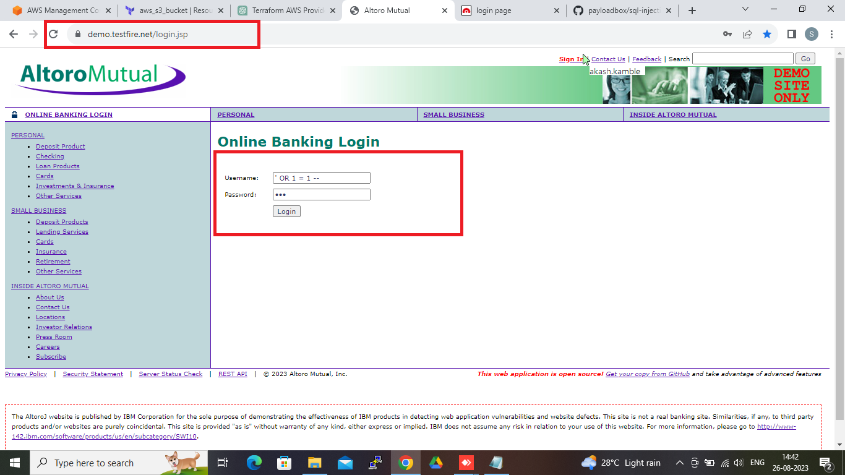

Slide 10
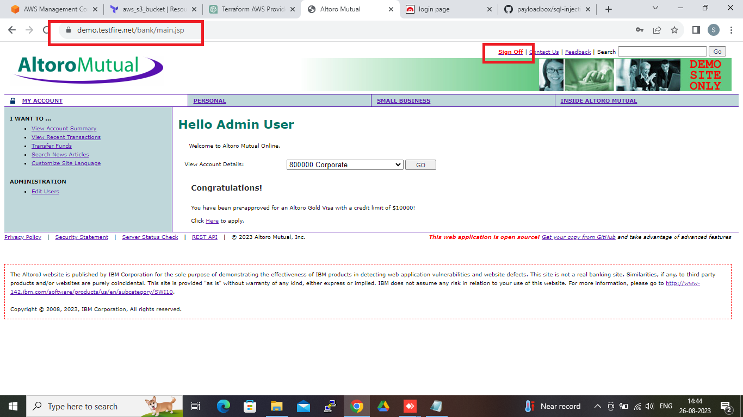

Slide 11
2. REFLECTED XSS:
Reflected XSS is a type of web security vulnerability where an attacker injects malicious scripts into web pages viewed by other users. These scripts are then executed by the users' web browsers, allowing the attacker to steal information, impersonate users, or perform actions on behalf of users without their consent.

Slide 12
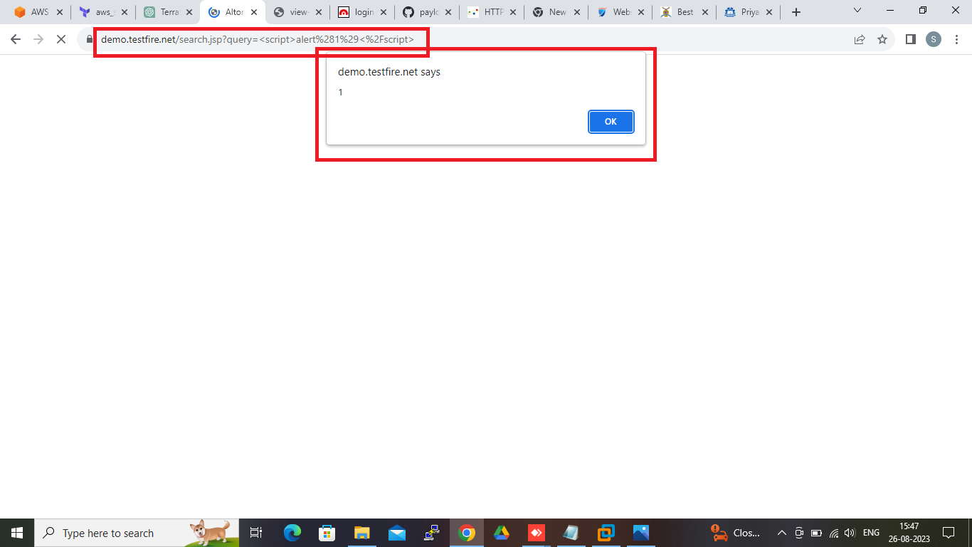

Slide 13
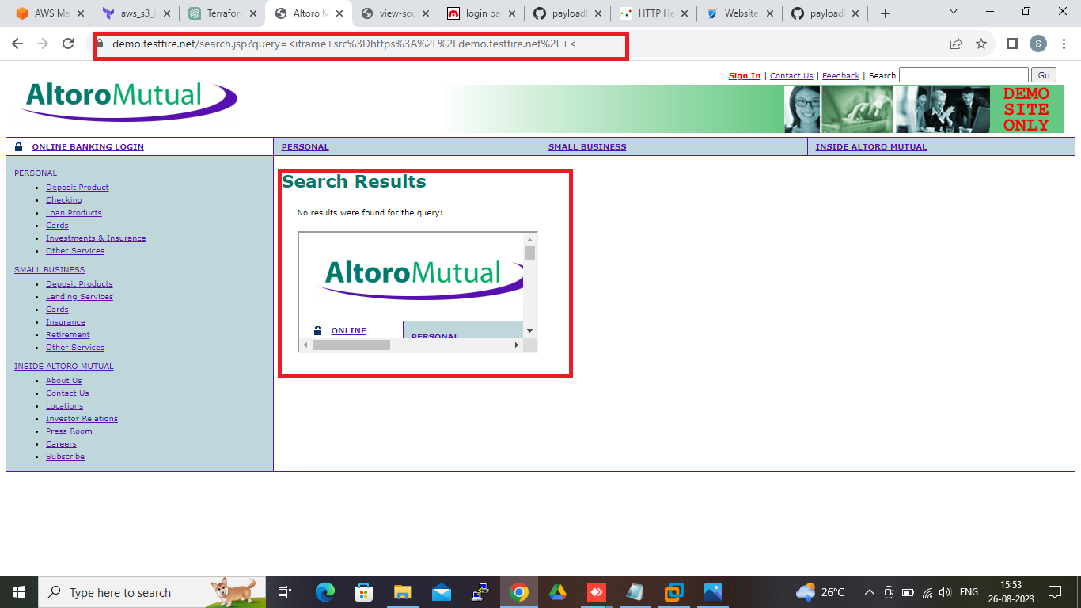

Slide 14
3. CLEARTEXT SUBMISSION OF USERNAME AND PASSWORD:
User credentials are transmitted over an unencrypted channel. This information should always be transferred via an encrypted channel (HTTPS) to avoid being intercepted by malicious users.

Slide 15
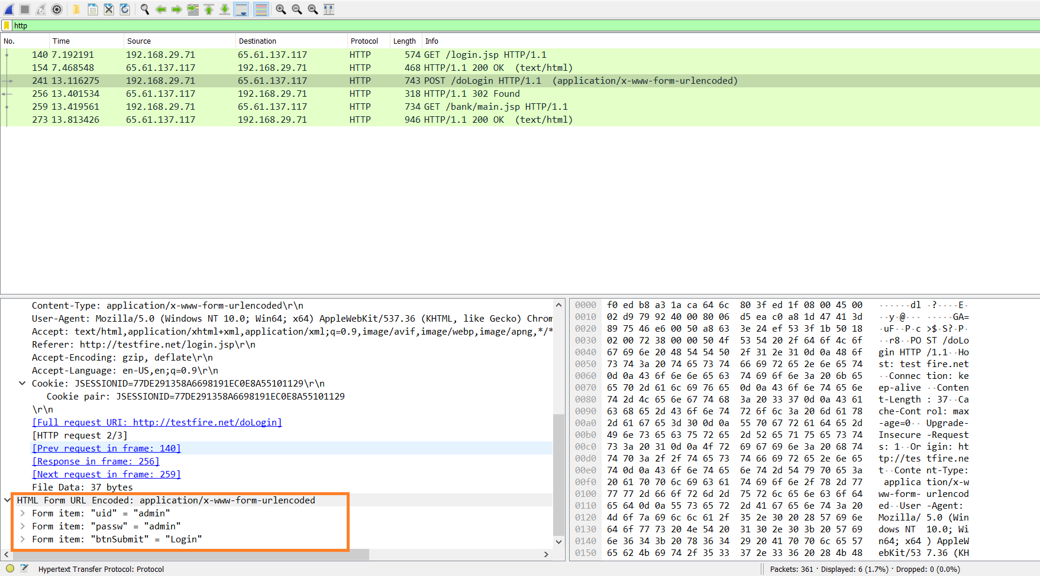

Slide 16
4. MISSING HTTP HEADERS:
HTTP security headers are a subset of HTTP headers that are related specifically to security. They are exchanged between a client (usually a web browser) and a server to specify the security details of HTTP communication. There are also other HTTP headers that, although not directly related to privacy and security, can also be considered HTTP security headers.

Slide 17
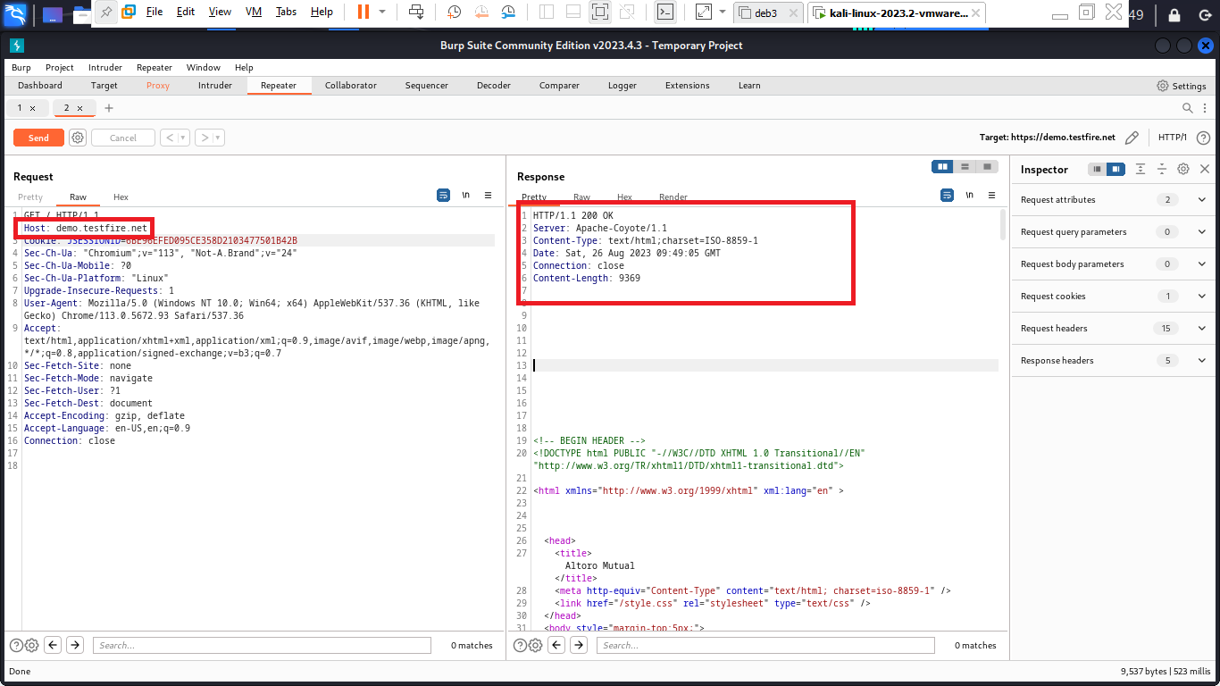

Slide 18
5. MULTIPLE SESSION LOGIN:
Weaknesses in this category are related to the design and architecture of session management. Frequently these deal with the information or status about each user and their access rights for the duration of multiple requests. The weaknesses in this category could lead to a degradation of the quality of session management if they are not addressed when designing or implementing a secure architecture.

Slide 19
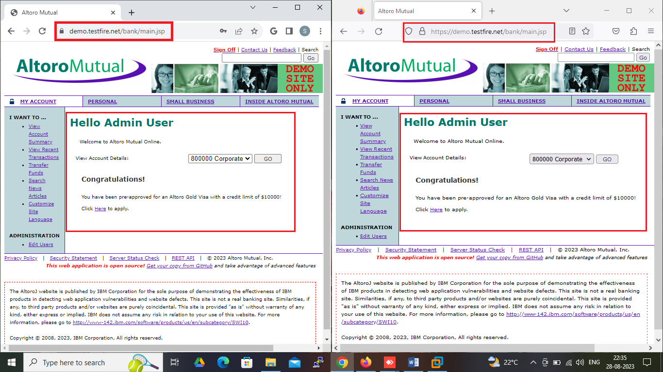

Slide 20
6. CLICKJACKING:
Clickjacking is a malicious technique of tricking a user into clicking on something different from what the user perceives, thus potentially revealing confidential information or allowing others to take control of their computer while clicking on seemingly innocuous objects, including web pages.

Slide 21
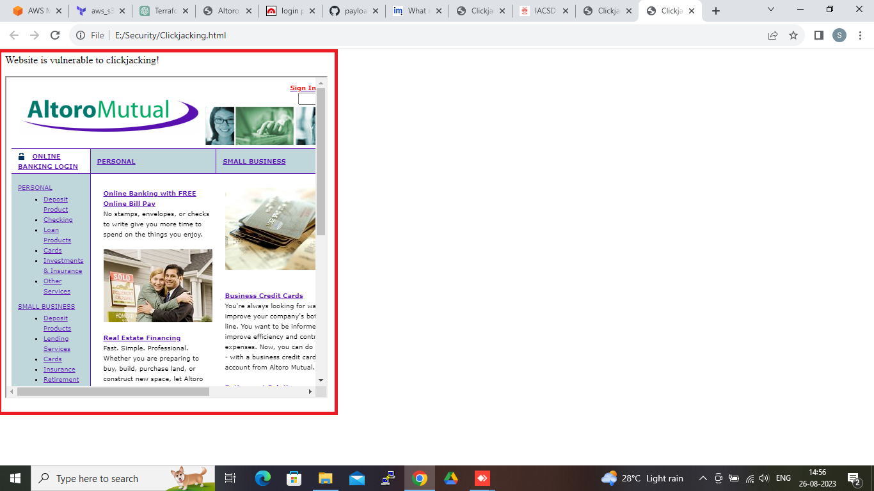

Slide 22
7. SERVER NAME DISCLOSED:
Server name and version disclosure occur when a web server or application server inadvertently reveals information about its identity and version in the HTTP response headers or error messages sent to clients. This information can include details like the server software's name (e.g., Apache, Nginx, Microsoft IIS) and the specific version number.

Slide 23
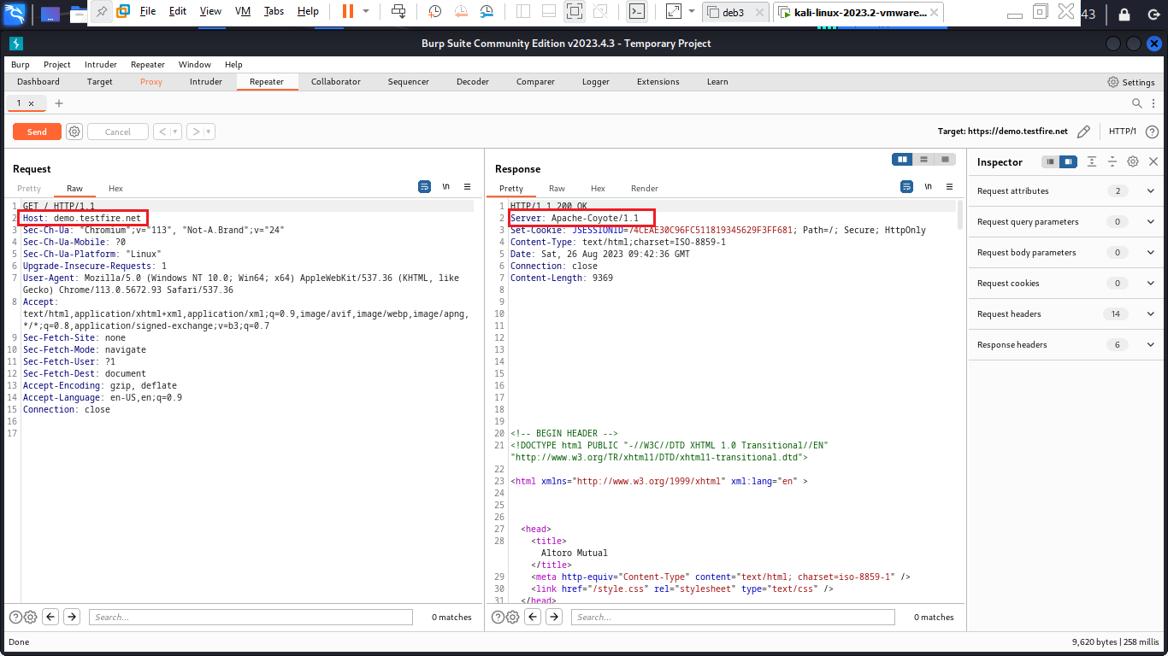

Slide 24
8. SECURE FLAG IS NOT SET:
A cookie has been set without the secure flag, which means that the cookie can be accessed via unencrypted connections. If the secure flag is not set, then the cookie will be transmitted in clear-text if the user visits any HTTP URLs within the cookie's scope. An attacker may be able to induce this event by feeding a user suitable links, either directly or via another web site.

Slide 25
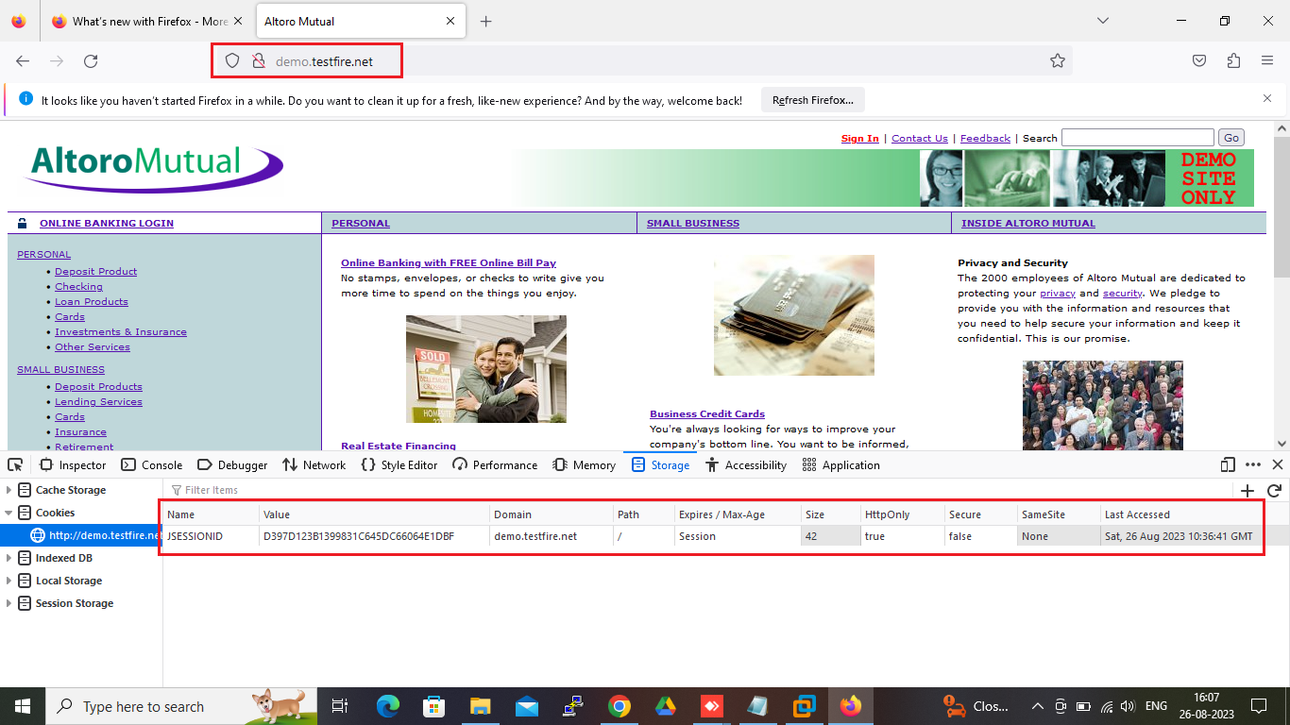

Slide 26
9. HTTP METHOD IS ENABLED:
PUT: HTTP method used for updating or replacing a resource on the server.
DELETE: HTTP method used to request the removal of a resource on the server.
OPTIONS: HTTP method used to request information about the communication options available for a resource.
CONNECT: HTTP method used to establish a network connection to a resource.
HEAD: HTTP method used to request headers and metadata about a resource, without the actual content.
DEBUG: Not a standard HTTP method; often used for debugging purposes in some development environments.
PATCH: HTTP method used for applying partial modifications to a resource on the server.

Slide 27
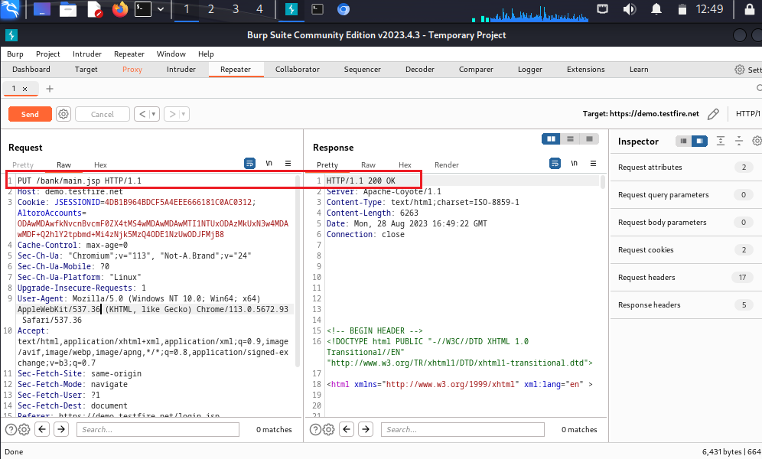

Slide 28
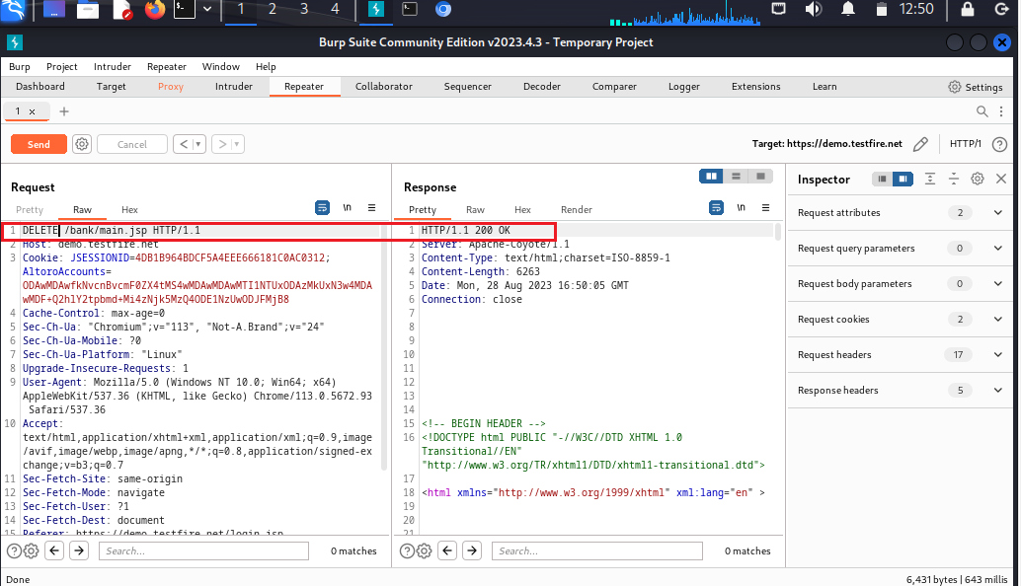

Slide 29
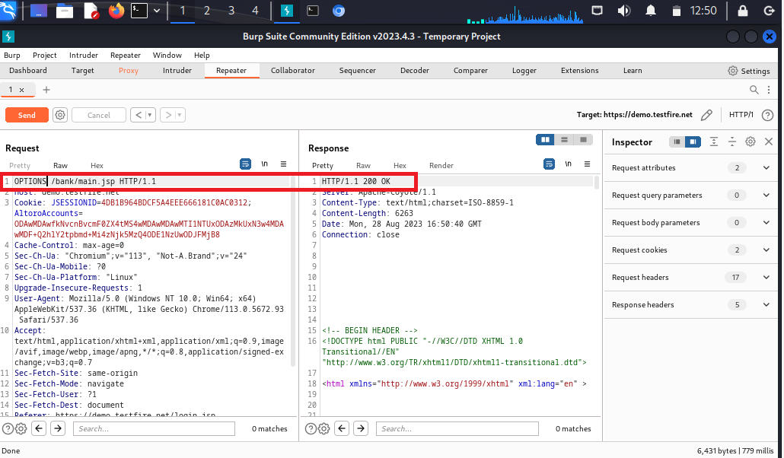

Slide 30
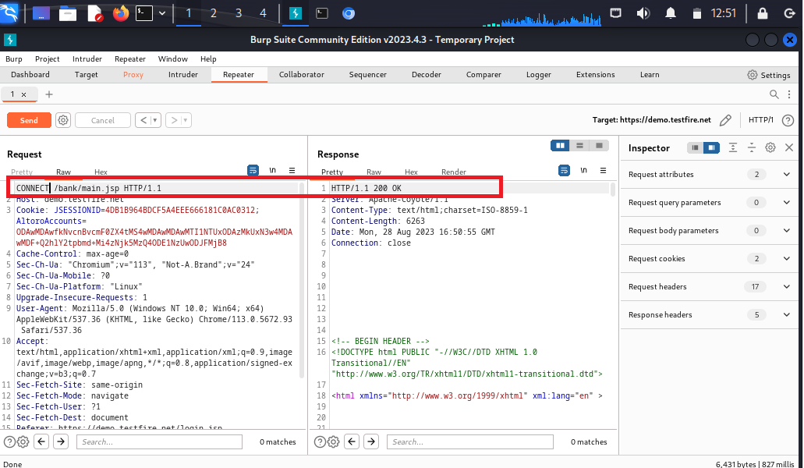

Slide 31
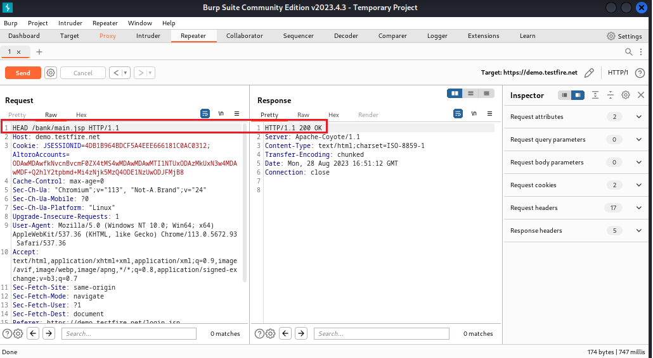

Slide 32
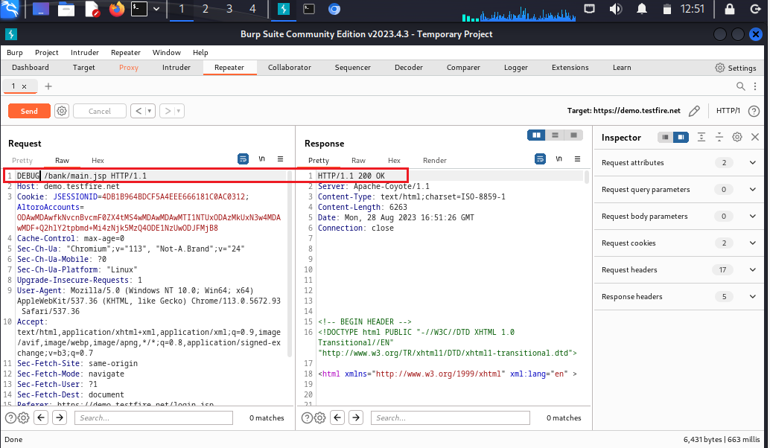

Slide 33


Slide 34
Conclusion:
In this project we explained how Vulnerability Assessment and Penetration Testing can be used as an effective cyber defence technology. We described why VAPT should be made a compulsory activity for cyber defence. We explained complete life cycle of VAPT, prevalent VAPT techniques. This project provide complete overview of Vulnerability Assessment and Penetration Testing, and its use as a cyber defence technology.

Slide 35

Thank You!

